Slide 1

Object oriented design - SOLID

Slide 2
Overview
How to build complex software?
  Structured programming
    gotos considered harmful
  Object oriented programming (OOP)
Language support alone isn't enough
  (or even strictly necessary)
  How we use the tools matters!
Objected oriented design (OOD)
  How do we design software that is easy to modify, extend and maintain?

Slide 3

Overview
Robert C. Martin "Uncle Bob"
  Author:
    Clean Code: A Handbook of Agile Software Craftsmanship
    Agile Software Development, Principles, Patterns, and Practices
    Agile Principles, Patterns, and Practices in C#
    The Clean Coder: A Code of Conduct for Professional Programmers
    …
http://butunclebob.com/ArticleS.UncleBob.PrinciplesOfOod

Slide 4
SOLID
How to manage dependencies in code?
  The first five principles - SOLID
SRP | Single responsibility principle
OCP | Open/closed principle
LSP | Liskov substitution principle
ISP | Interface segregation principle
DIP | Dependency inversion principle

Slide 5
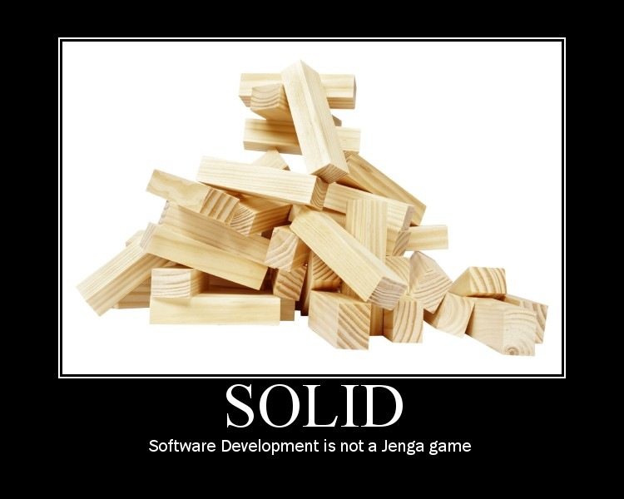
http://lostechies.com/derickbailey/2009/02/11/solid-development-principles-in-motivational-pictures/

Slide 6
Single Responsibility Principle (SRP)
"A class should have only one reason to change."
Strive for cohesion
  Functional relatedness of the elements of a module
  The forces that cause a module, or a class, to change
SRP | Single responsibility principle
OCP | Open/closed principle
LSP | Liskov substitution principle
ISP | Interface segregation principle
DIP | Dependency inversion principle

Slide 7
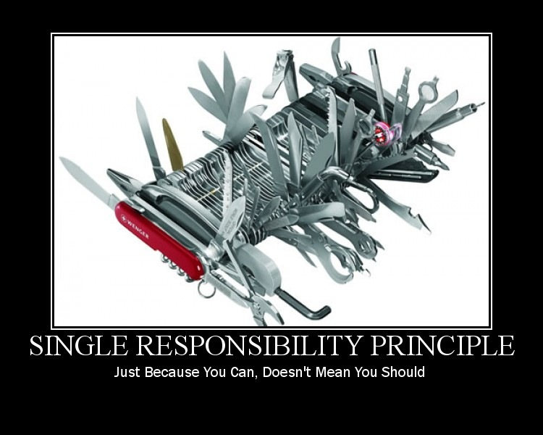
http://lostechies.com/derickbailey/2009/02/11/solid-development-principles-in-motivational-pictures/

Slide 8
Single Responsibility
public class Book { private String name; private String author; private String text; //constructor, getters and setters }

Slide 9
Single Responsibility
public class Book { private String name; private String author; private String text; //constructor, getters and setters // methods that directly relate to the book properties public String replaceWordInText(String word){ return text.replaceAll(word, text); } public boolean isWordInText(String word){ return text.contains(word); } }

Slide 10
Single Responsibility
public class Book { private String name; private String author; private String text; //constructor, getters and setters // methods that directly relate to the book properties public String replaceWordInText(String word){ return text.replaceAll(word, text); } public boolean isWordInText(String word){ return text.contains(word); } // methods for outputting text void printTextToConsole(String text){ //our code for formatting and printing the text } void printTextToAnotherMedium(String text){ // code for writing to any other location.. } }

Slide 11
Single Responsibility
public class Book { //... void printTextToConsole(){ // our code for formatting and printing the text } }
public class BookPrinter { // methods for outputting text void printTextToConsole(String text){ //our code for formatting and printing the text } void printTextToAnotherMedium(String text){ // code for writing to any other location.. } }

Slide 12
Single Responsibility
“One class should have one and only one responsibility”
Person.java
public class Person { private Long personId; private String firstName; private String lastName; private String age; private List<Account> accounts; }
Account.java
public class Account { private Long guid; private String accountNumber; private String accountName; private String status; private String type; }

Slide 13
Open/closed principle (OCP)
"Classes should be open for extension,
but closed for modification."
Principle underlying common heuristics:
  All instance variable should be private
  Avoid global variables
Design modules that never change
SRP | Single responsibility principle
OCP | Open/closed principle
LSP | Liskov substitution principle
ISP | Interface segregation principle
DIP | Dependency inversion principle

Slide 14
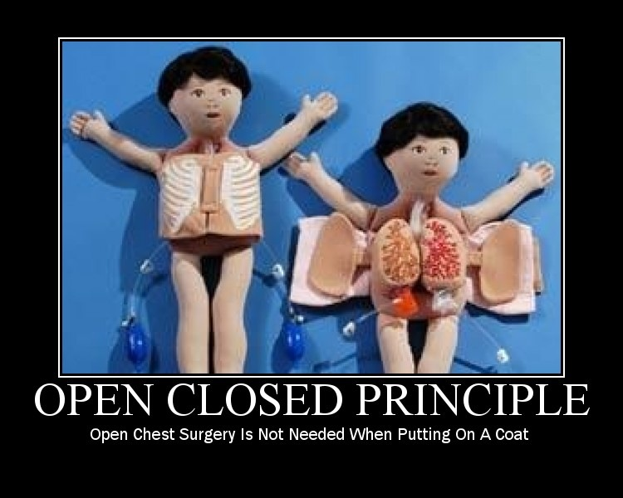
http://lostechies.com/derickbailey/2009/02/11/solid-development-principles-in-motivational-pictures/

Slide 15
Open Closed Principle
“Software components should be open for extension, but closed for modification”
Guitar.java
public class Guitar { private String make; private String model; private int volume; //Constructors, getters & setters }
FlameGuitar.java
public class SuperCoolGuitarWithFlames extends Guitar { private String flameColor; //constructor, getters + setters } }

Slide 16
Liskov Substitution principle
"Derived classes must be substitutable for their base classes."
The base class should not have to know about all of its derivatives
SRP | Single responsibility principle
OCP | Open/closed principle
LSP | Liskov substitution principle
ISP | Interface segregation principle
DIP | Dependency inversion principle

Slide 17
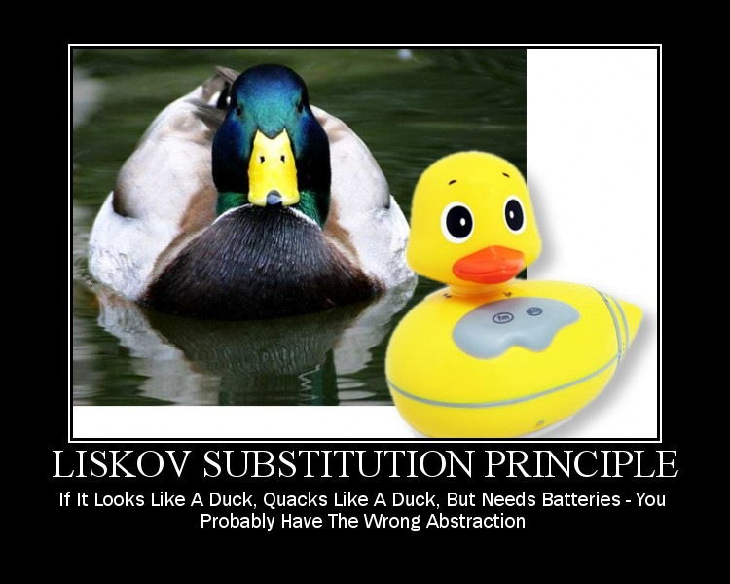
http://lostechies.com/derickbailey/2009/02/11/solid-development-principles-in-motivational-pictures/

Slide 18
Liskov Substitution if class A is a subtype of class B, then we should be able to replace B with A without disrupting the behavior of our program.
public interface Car { void turnOnEngine(); void accelerate(); }
public class ElectricCar implements Car { public void turnOnEngine() { throw new AssertionError("I don’t have an engine!"); } public void accelerate() { //this acceleration is crazy! } }
public class MotorCar implements Car { private Engine engine; public void turnOnEngine() { //turn on the engine! engine.on(); } public void accelerate() { //move forward! engine.powerOn(1000); }}
One possible solution would be to rework our model into interfaces that take into account the engine-less state of our Car.

Slide 19
Interface segregation principle (ISP)
"Clients should not be forced to depend upon interface that they do not use."
We don't want "fat" or "polluted" interfaces
  Interfaces that are not specific to a single client leads to inadvertent coupling between clients that would otherwise be isolated
SRP | Single responsibility principle
OCP | Open/closed principle
LSP | Liskov substitution principle
ISP | Interface segregation principle
DIP | Dependency inversion principle

Slide 20
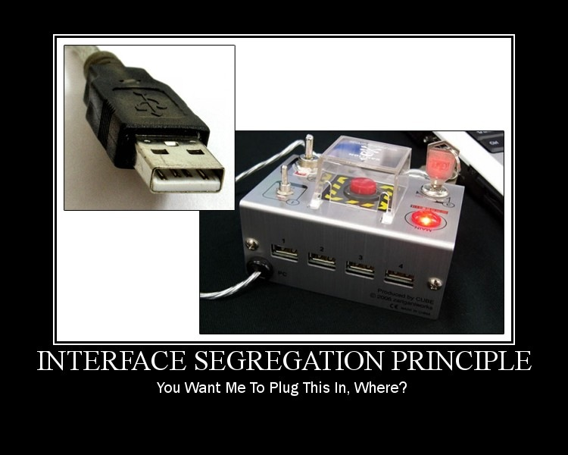
http://lostechies.com/derickbailey/2009/02/11/solid-development-principles-in-motivational-pictures/

Slide 21
Interface Segregation
Interface to be implemented
public interface BearKeeper { void washTheBear(); void feedTheBear(); void petTheBear(); }
Implement accordingly
public class BearCarer implements BearCleaner, BearFeeder { public void washTheBear() { //I think we missed a spot... } public void feedTheBear() { //Tuna Tuesdays... } }
Separate the interfaces as required
public interface BearCleaner { void washTheBear(); } public interface BearFeeder { void feedTheBear(); } public interface BearPetter { void petTheBear(); }
Leave dangerous stuff to crazy people
public class CrazyPerson implements BearPetter { public void petTheBear() { //Good luck with that! } }

Slide 22
Dependency inversion principle (DIP)
"Depend on abstractions.
Do not depend upon concrete classes."
High-level components should not depend on low-level components
  Both should depend on abstractions
    Abstract classes should not depend upon concrete classes
    Concrete classes should depend on abstract classes
SRP | Single responsibility principle
OCP | Open/closed principle
LSP | Liskov substitution principle
ISP | Interface segregation principle
DIP | Dependency inversion principle

Slide 23
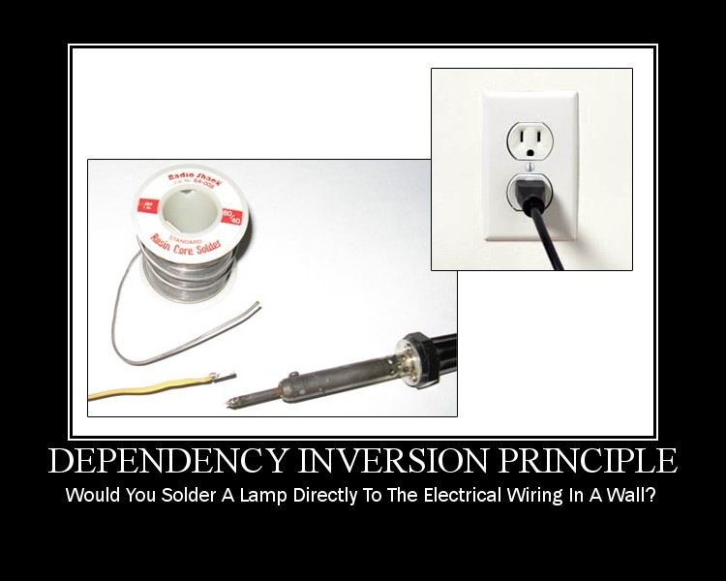
http://lostechies.com/derickbailey/2009/02/11/solid-development-principles-in-motivational-pictures/

Slide 24
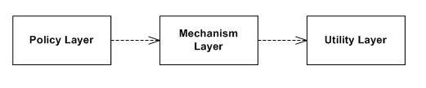
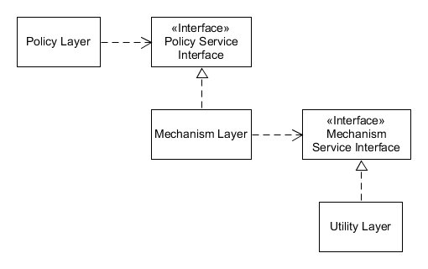
Dependency Inversion
The principle of Dependency Inversion refers to the decoupling of software modules. This way, instead of high-level modules depending on low-level modules, both will depend on abstractions.
In conventional application architecture, lower-level components (e.g., Utility Layer) are designed to be consumed by higher-level components (e.g., Policy Layer) which enable increasingly complex systems to be built.
In this composition, higher-level components depend directly upon lower-level components to achieve some task.
This dependency upon lower-level components limits the reuse opportunities of the higher-level components.

Slide 25
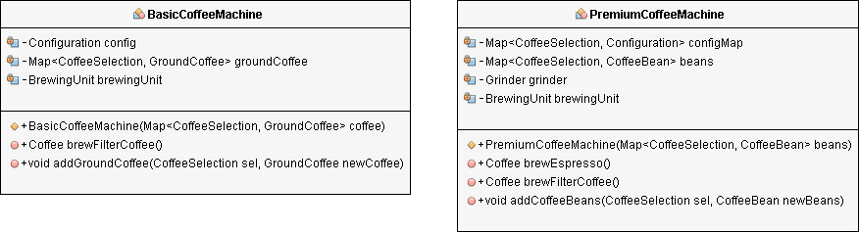
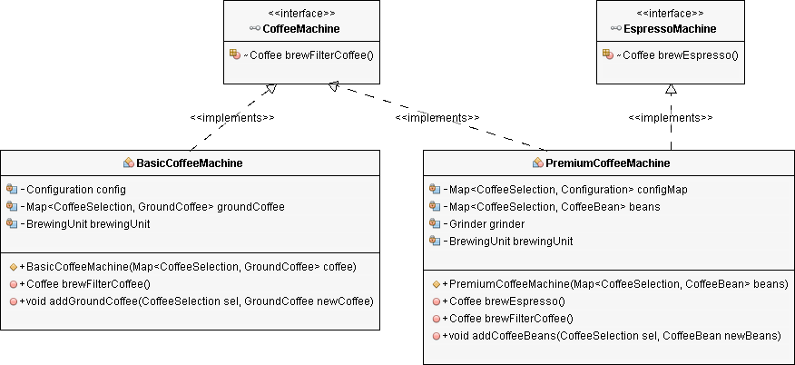
https://stackify.com/dependency-inversion-principle/

Slide 26
https://www.baeldung.com/solid-principles

Slide 27
Thanks

